Slide 1
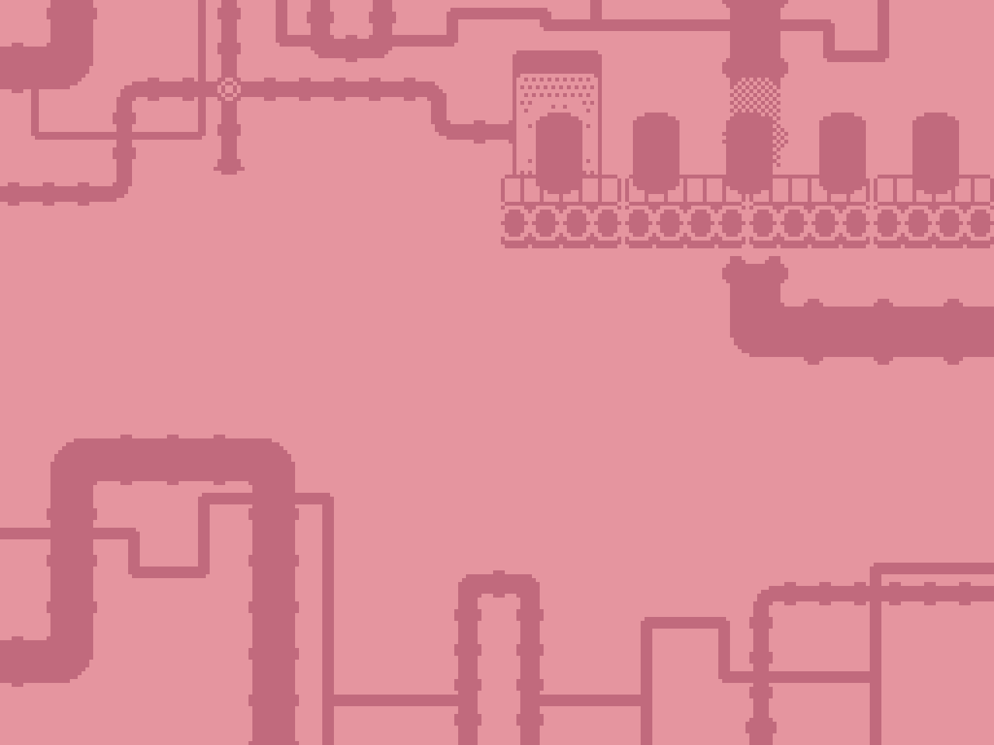
Fizz Frisk Concept Pitch
Corey (He/Him)
Cody (He/Him)
Jamie (He/Him)

Slide 2
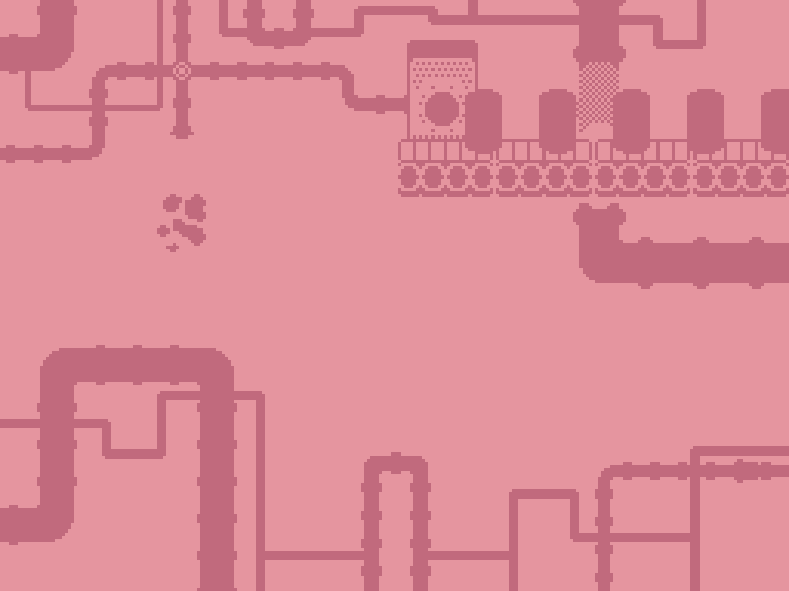
Overview
Fizz Frisk is a simple, casual 2D game.
The player assumes the role of a new worker at the Atomic Elixir canning facility.
They must ensure that no contaminated drinks pass through the conveyor belt and are sent out for shipping.

Slide 3
Gameplay
The goal for the player is to obtain as many points as they can.
The player will lose if they run out of lives.
There is no time limit restriction, get as many points as you can!

Slide 4
Core Mechanics
A conveyor belt will move cans past the player, these cans can be either safe or contaminated.
The player can inspect the cans with an X-ray device to inspect them for imperfections/contaminants.
Any can is able to be picked up from the conveyor belt and trashed by the player.
For each safe can the player allows through, they receive 1 point.
For each contaminated can the player allows through or each safe can they trash, they lose 1 life.

Slide 5
Level Overview
Fizz Frisk contains a single level set inside of an industrial canning facility.
Machinery such as conveyor belts, pipes, steam machines and warning lights and signs are abundant.
The factory is well lit with distant machinery visible in the background of the level.
The industrial setting of the game will inform our sound design choices.

Slide 6
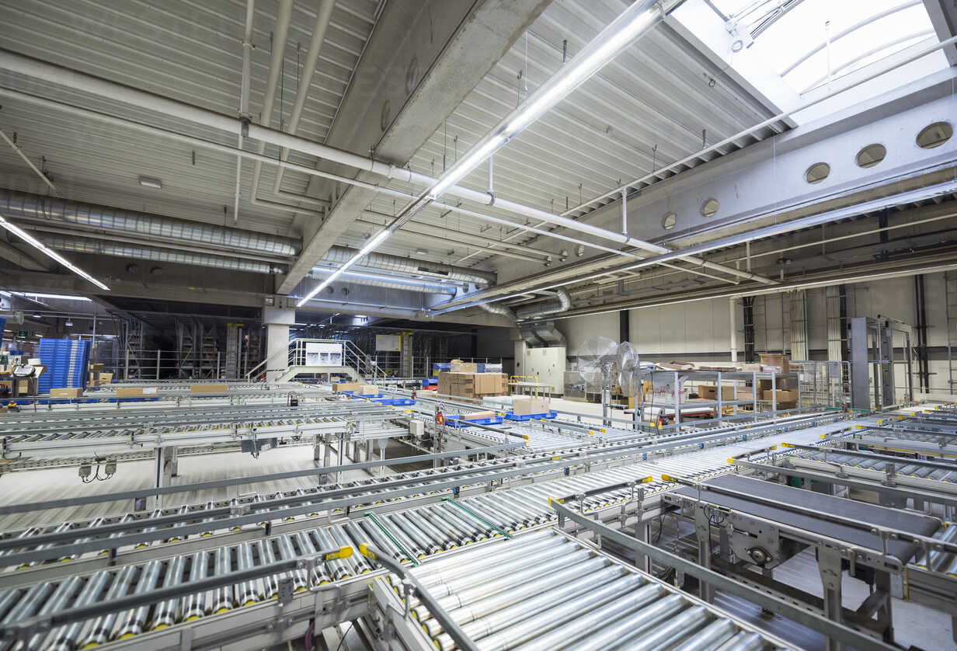
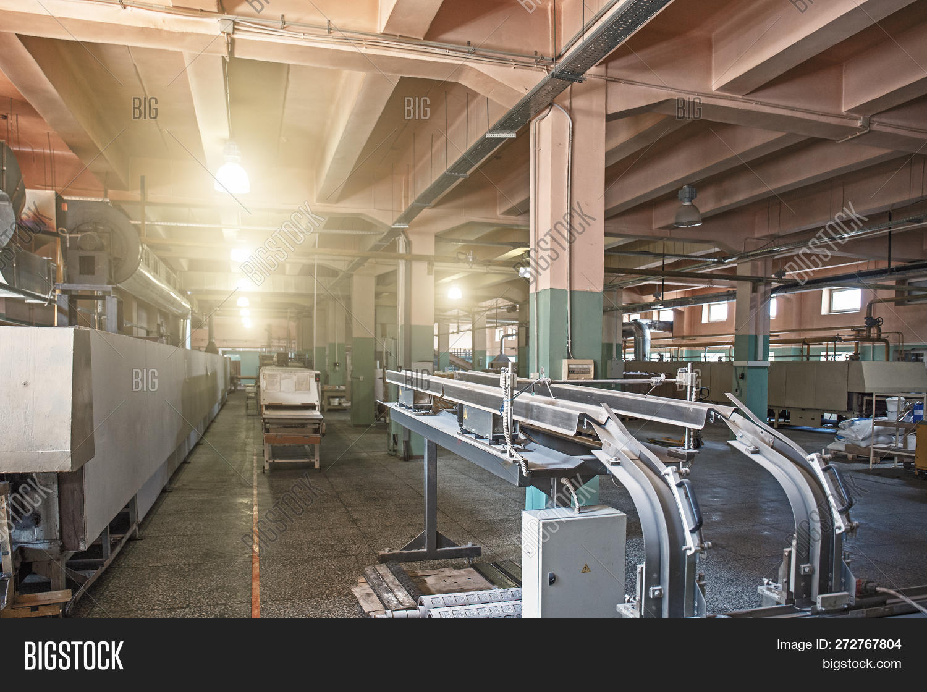
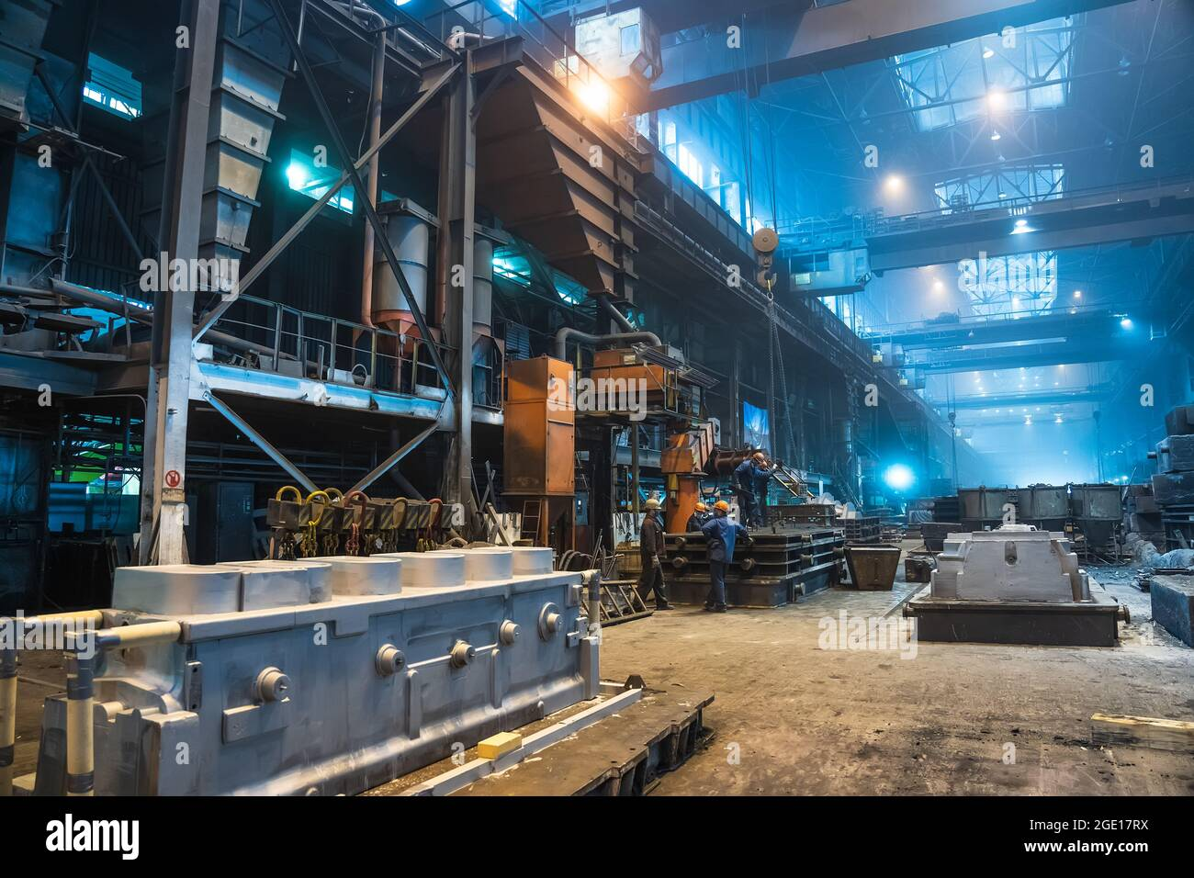
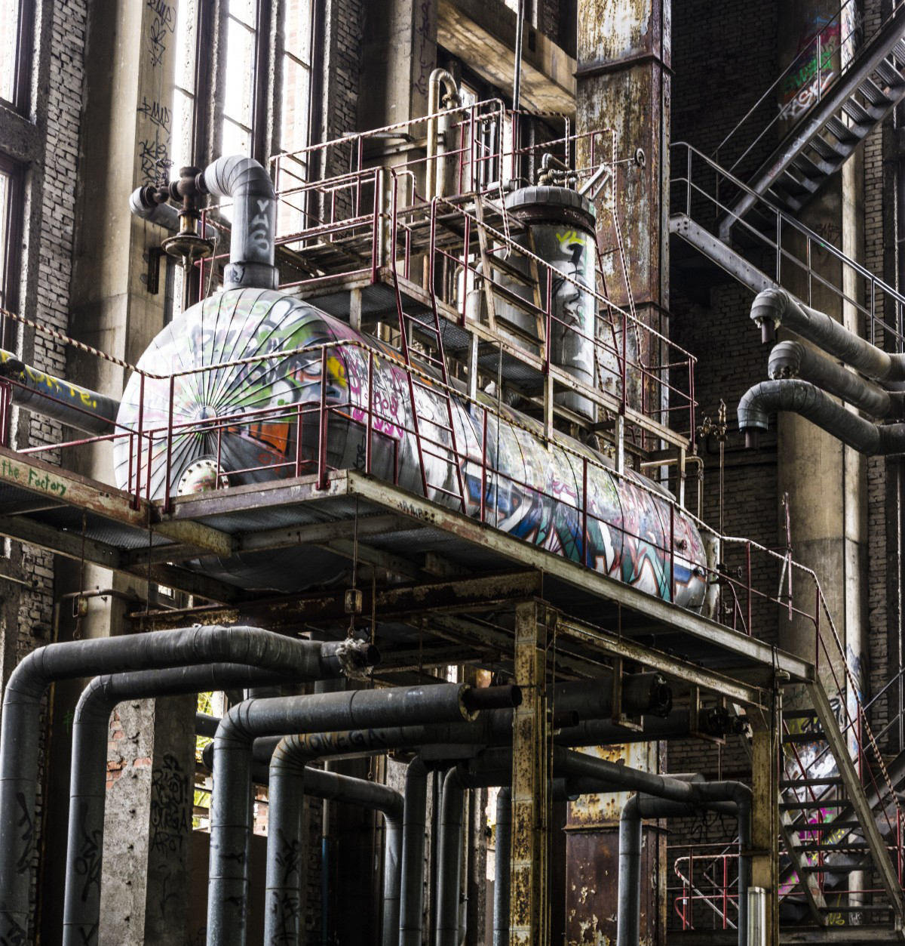
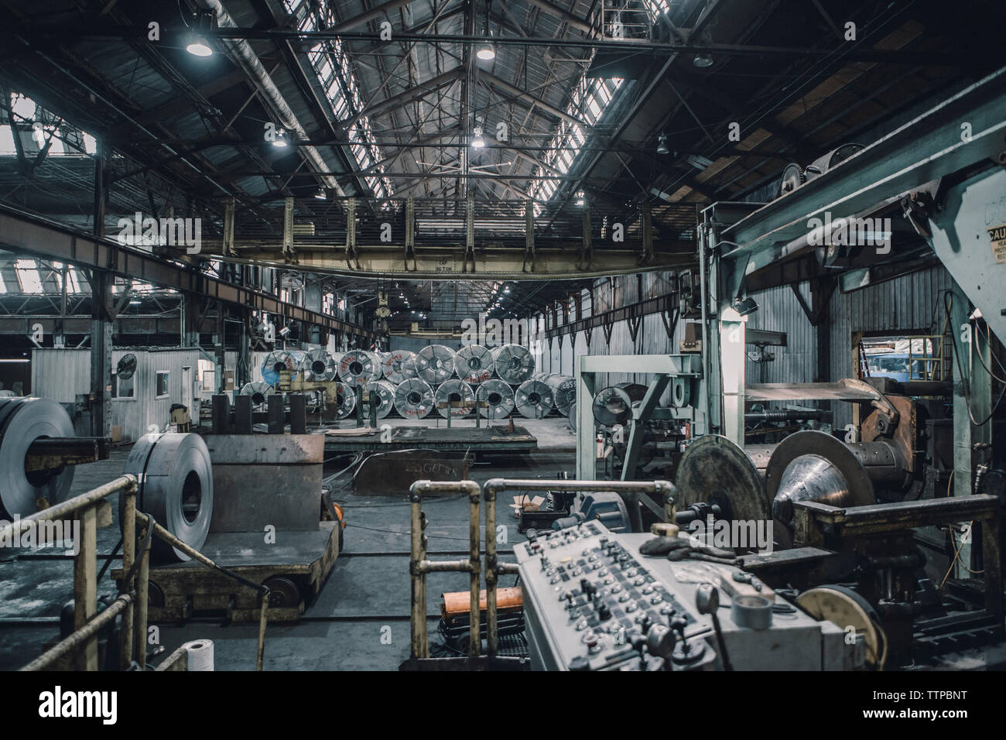
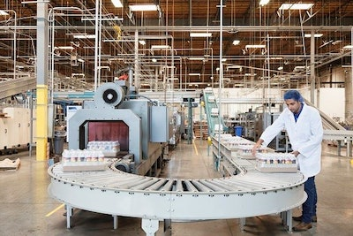
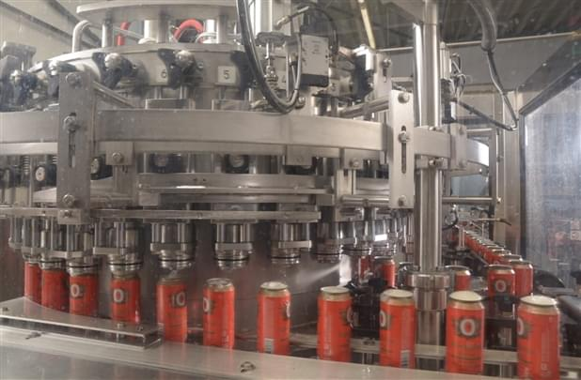
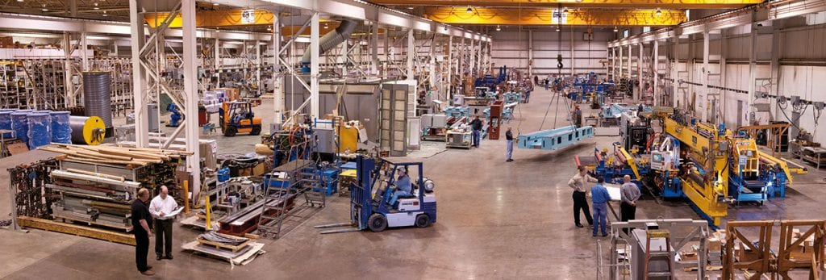
Mood Board

Slide 7

Soundscape
The sound design and music of Fizz Frisk will reflect the industrial/factory setting of the game as well as the pixel-art style.
Fizz Frisk will use a simple looping soundtrack that is light-hearted, catchy, retro and warm to reflect the simplistic nature of the game.
SFX will use low sample sizes and bit rates to achieve a retro audio style, similar to other pixel art-based games.
To evoke the sense that the player is inside a factory, ambient industrial and mechanical sounds (conveyor belts looping, engines whirring, steam pressure, etc.) will also be implemented.

